Slide 1
AI-Based Industrial Problem Solving
“The key to artificial intelligence has always been the representation” ~Jeff Hawkins
Team INNOVATORS ~Darshan Gujjar
~Aditya Khatri ~Meet Parmar ~Dhaval Sundhesha

Slide 2

optimization of inventory levels in a product base business
Problem Statement : In today's competitive market, product-based businesses face significant challenges in maintaining optimal inventory levels to meet customer demand while minimizing holding costs. Traditional methods of inventory management, often reliant on historical data and fixed reorder points, can lead to either overstocking, which ties up capital and increases storage costs, or understocking, resulting in missed sales opportunities and customer dissatisfaction.
Justification : Cost Efficiency and Scalability Enhancing Supply Chain Efficiency Real-Time Data Processing and Decision-Making Predictive Capabilities of AI

Slide 3


Available options and scope of improvement
Existing Solutions and Industry Reports : 1) AI-Powered Demand Forecasting : AI-driven demand forecasting models (such as machine learning algorithms) predict future demand by analyzing historical sales data, market trends, customer behavior, and external factors Example : Amazon uses AI models to anticipate spikes in demand based on shopping behavior and external events, optimizing inventory replenishment. 2) AI-Enhanced Inventory Auditing : AI and computer vision automate the auditing and tracking of inventory levels in warehouses, improving accuracy and reducing labor costs. Examples : JD.com (China) uses AI drones to automate warehouse auditing significantly reducing operational costs.

Slide 4
Some Of the limitations :
Amazon Strengths: Advanced AI-powered demand forecasting: Amazon’s ability to predict demand based on extensive data, including shopping behavior and external factors, allows it to optimize inventory placement across fulfillment centers and reduce lead times.
Limitations: Data privacy concerns: Handling and processing massive amounts of customer data raise security challenges, especially with regulatory requirements .
JD.com: Strengths: End-to-end inventory management: The company leverages AI to track and optimize inventory across its entire supply chain, from warehouses to last-mile delivery.
Limitations: Regulatory hurdles: As JD.com expands globally, it may face different regulatory requirements around AI and drone use, which could slow down its AI adoption in certain regions.

Slide 5


Data required to solve
Following are the key Data required to solve the problem:
Historical Sales Data Inventory Data Demand Forecasting Data Supplier Data Customer Data Market Data Logistics and Transportation Data Product Data Data Collection Sources : Enterprise Resource Planning (ERP) Systems Point of Sale (POS) Systems Warehouse Management Systems (WMS) Customer Relationship Management (CRM) Systems Social Media and Online Sentiment Analysis

Slide 6
SOLUTION DESIGN
Some of the AI Techniques and Algorithms: Demand Forecasting Inventory Optimization Supplier and Replenishment Management Supply Chain and Logistics Optimization
Overview of the model: Input Stage: In this stage, the AI model takes in relevant data related to inventory management Processing Stage : This stage is where the AI model processes the input data using advanced machine learning algorithms.| Output Stage: The output stage involves generating actionable insights and recommendations to optimize inventory levels.
Example Workflow:
Input: Historical sales data, current stock levels, demand forecasts.
Processing: AI models predict demand, calculate optimal reorder points.
Output: Inventory recommendations, reorder schedules, and alerts for low stock or excess inventory.

Slide 7
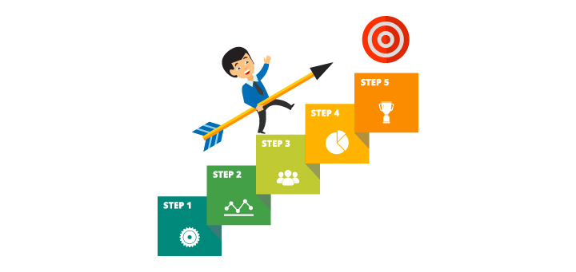

Execution and deployment plan
Step 1: Define Project Scope and Objectives
Step 2: Data Collection and Understanding
Step 3: Data Preprocessing
Step 4: Model Selection and Development
Step 5: Model Training and Evaluation
Step 6: Model Validation and Testing
Step 7: Integration with Inventory Management Systems
Step 8: Deployment and Monitoring
Step 9: Performance Tuning and Feedback Loop
Step 10: Documentation and Final Reporting

Slide 8

OBJECTIVE AND CONCLUSION
The primary goal of this project is to leverage artificial intelligence (AI) to optimize inventory management, reduce stockouts, minimize holding costs, and improve overall efficiency in a product-based business. The project aims to provide accurate demand forecasting and effective inventory replenishment strategies.

